Slide 1
WEEK
6
GROCERY STORE

Slide 2
ON THE MENU
RECAP
Comparing Products
NAVIGATING THE GROCERY STORE
Perimeter
Center Aisles
FRESH, CANNED, FROZEN
Which Is Best?
SCAVENGER HUNT
KNOWLEDGE CHECK

Slide 3
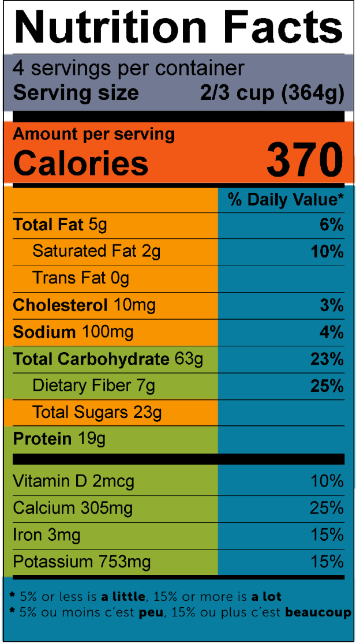
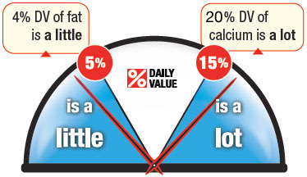
LABEL READING
RECAP
INGREDIENTS: ROASTED PEANUTS, CORN SYRUP SOLIDS, SUGAR, SOY PROTEIN CONCENTRATE, SALT, PALM KERNAL OIL (TO PREVENT SEPERATION), MONO- AND DIGLYCERIDES, MINERALS (OXIDE, ZINC OXIDE, FERRIC ORTHOPHOSPHATE, COPPER SULFATE), VITAMINS (NIACINAMIDE, PYRIDOXINE HYDROCHLORIDE, FOLIC ACID).

Slide 4
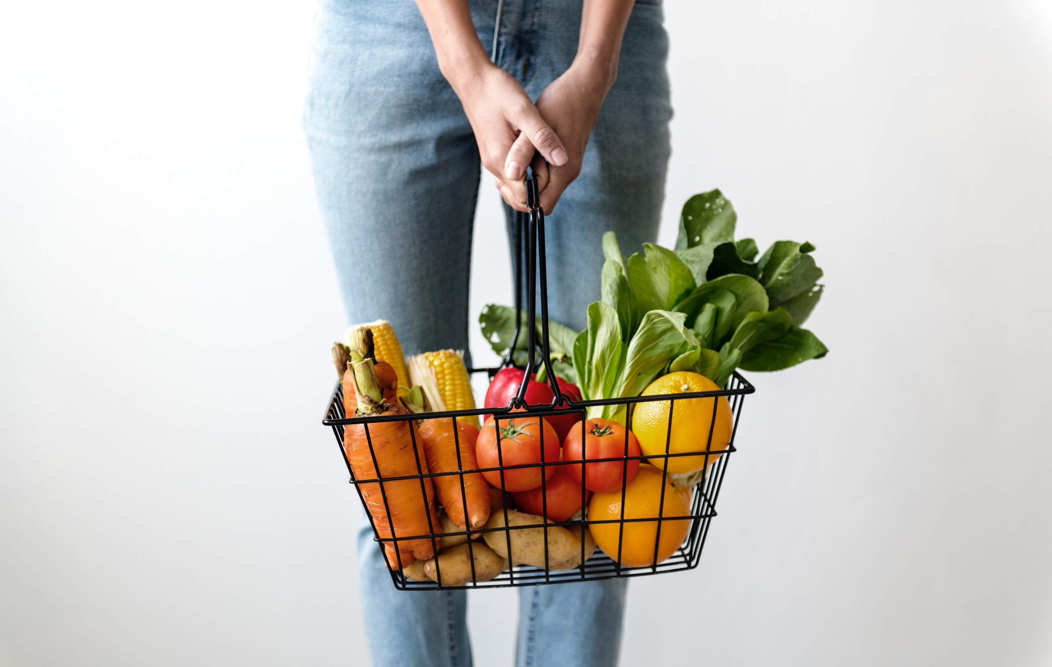
SHOP THE PERIMETER

Slide 5
FRESH BREADS
FRESH MEATS, POULTRY, AND SEAFOOD
DAIRY, EGGS, AND DAIRY ALTERNATIVES
FRESH FRUITS AND VEGETABLES
FROZEN FRUITS, VEGETABLES, MEATS, FISH

Slide 6
Shop the perimeter
EXCEPTIONS
In general, the perimeter has some great healthy options. But there are always exceptions to this rule:
EXCEPTIONS
Processed meats
Frozen desserts and meals
Bakery and desserts

Slide 7
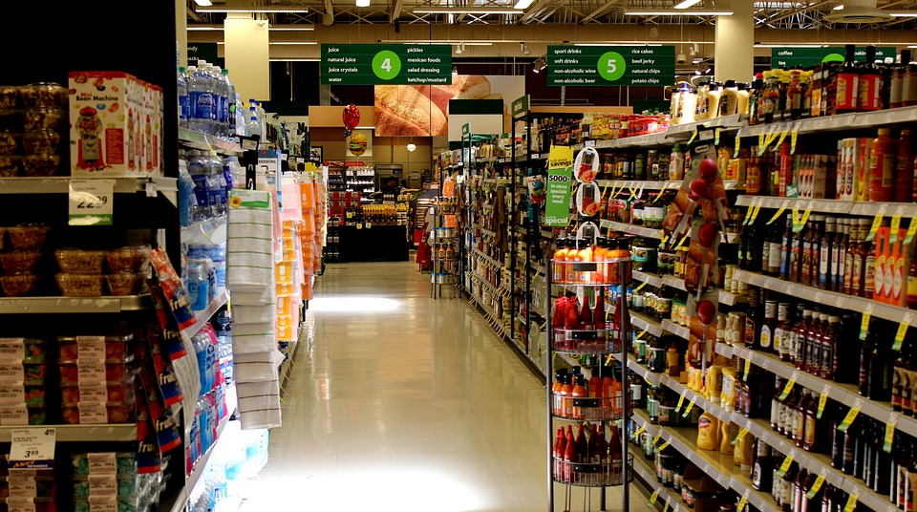
WHAT ABOUT THE CENTER AISLES?

Slide 8
CENTER AISLES BEST BUYS
LOOK FOR
NO-SALT-ADDED canned or jarred tomatoes
Canned fruit in WATER or JUICE (not syrup!)
Canned vegetables (beans, mushrooms, corn, beets)
Dried or NO-SALT-ADDED canned beans, peas, and lentils (chickpeas, black beans)
Nuts and Seeds (UNSALTED)
Canned tuna and salmon
WHOLE GRAINS: rice, pasta, quinoa
WHOLE GRAIN and HIGH FIBRE cereals

Slide 9
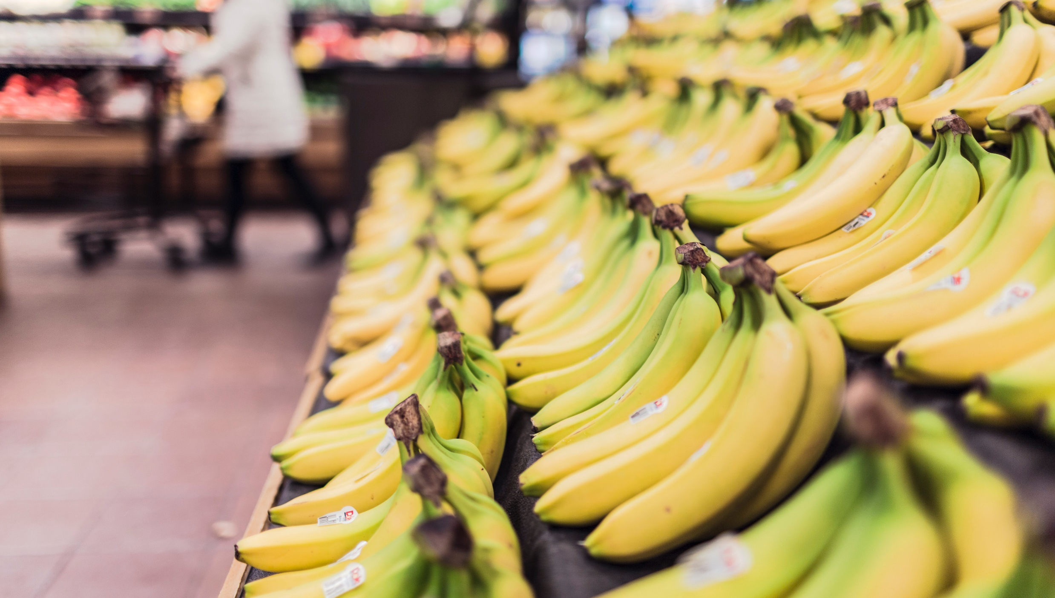
WHERE CAN YOU FIND it?
WHERE ARE THE FRUITS AND VEGETABLES IN THE GROCERY STORE?

Slide 10
WHICH IS BEST?
FRESH
CANNED
FROZEN
PROS:
PROS:
PROS:
Less expensive
Convenient
Less expensive
Nutrition quality
Convenient
Less expensive (If in season)
Texture
Nutrition quality (if in season)
CONS:
CONS:
CONS:
Flavour/ Texture
Flavour/ Texture
Nutrition quality
Added salt/sugar
Flavour/ Texture
More expensive (if not in season)
Go bad faster
Less choice
Added salt/sugar
TIP: Shop in season to save money
TIP: Check the ingredient list and look for minimal salt and sugar
TIP: Check the ingredient list and look for minimal salt and sugar

Slide 11
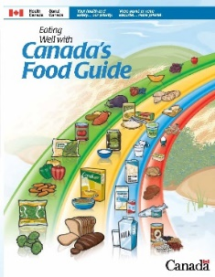
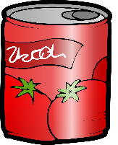
KNOWLEDGE CHECK
1
2
3
SHOP THE PERIMETER
THE INSIDE COUNTS
FRESH, CANNED, FROZEN
No salt added
Canned or dried beans
Unsalted
Packed in juice or water
Whole grains
Canned fish

Slide 12
Scavenger Hunt
Decide teams and names
30 minutes to complete scavenger hunt
Assign facilitators to each group
Remember to work quietly as the supermarket is a work place and they are letting us use their space
Act respectfully
Have FUN!

Slide 13
Thank you to our sponsor
Canada’s Children’s Hospital Foundations (CCHF) is grateful for Sun Life Financial’s $2 million commitment to support the creation of Meant2Prevent: A type 2 diabetes prevention initiative for children and youth presented by Sun Life. As part of Sun Life Financials’ Team Up Against Diabetes platform, this partnership allows the children’s hospital network of experts to positively influence children and youth to live healthier lives through awareness and education. Thank you Sun Life Financial for your dedication to building sustainable, healthier communities and families by helping to prevent type 2 diabetes.

Slide 14
This project is part of
www.Meant2Prevent.ca
www.Meant2PreventKitchen.ca

